Slide 1


Av
Yngve Sture Christian Aalby Svalesen
Data pipelines for ML
Gjensteforelesning for BI GRA4157
1

Slide 2

Mo d e r n d a t a pl a t f o r m s
15 min. Markus: 19-24
In tr o t o Be a r i n gp o i n t
5 min
Va l u e d r i v e n d e s i g n
10 min
Pl a a ce E x a m p l e
10 min
ML s y s t e m d e s i g n wo rks h o p
10 min
ML u s e c a s e
10 min
w o r k s h o p
ML O p s
20 min. Markus (slide 12-19)
P r ac t ic al e x p e r ie n c e s
10 min
2

Slide 3
Intro to BearingPoint

Slide 4























We have European roots, with global reach
4 261
employees globally and 150 in Norway
50
countries were we consult clients
41
Offices in 23 countries
€738m
In revenue

Slide 5
DATA ENGINEERING & INSIGHT
DATA ADVISORY
DATA SCIENCE & AI
Leverandør- og teknologi-
uavhengig
rådgiver
70+
konsulenter i Oslo
20+
års erfaring
5

Slide 6



















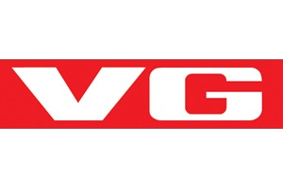




DATA ENGINEERING & INSIGHT
DATA ADVISORY
DATA SCIENCE & AI
6

Slide 7
Value driven design

Slide 8
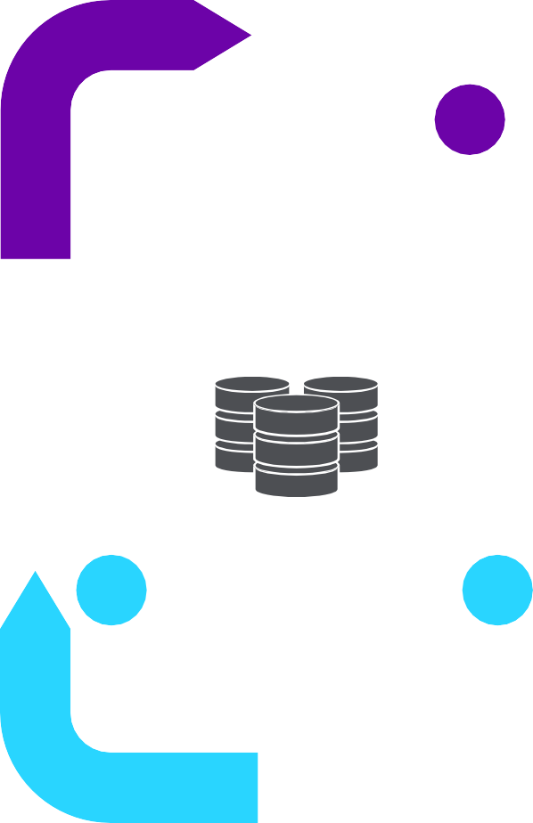

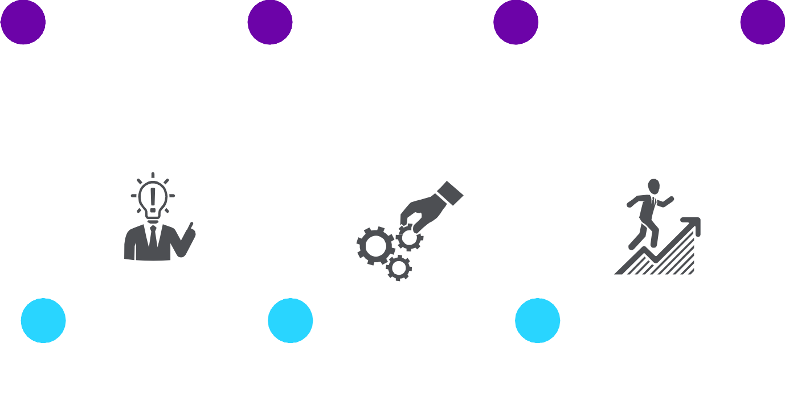



Our approach has the desired business value in focus throughout the initiative …
BearingPoint’s Value Driven Data & Analytics Framework
…but successful D&A initiatives should start here
Value Driven Design
5
4
3
2
1
What data do we need
to conduct the specified analysis?
Is that data available?
What analytical approach can provide the desired
insight and enable the desired action?
Which insight is needed to enable the desired
way of working?
What would we do differently, in order to reach the goal, if we had more relevant insight?
What strategic goal should we leverage data to reach?
Data
Analyses
Insight
Action
Value
Implementation starts here…
6
7
8
9
Re-engineer processes and organization toward data driven actions based on new insight
10
Collate relevant data, establish new infrastructure if necessary
Conduct specified analysis. Can be either one-off initiative or on- going analysis capability
Evaluate generated insight from both a technical- and business perspective. Is it useful?
Measure and assess business impact continuously
Business and Technology Implementation
8

Slide 9
ML use case workshop

Slide 10


Cases
How to turn value into data
B2B Sales
Large international cloud provider.
More than 90% of all revenue comes from B2B sales.
Security and price are important drivers in the market.
Many customers still believe cloud computing is dangerous and unsafe.
Strategic goal: Increase revenue by 10% within 3 years.
Telecommunication
National telecommunications provider.
Market is fierce with many providers and low margins, making every customer very valuable.
Retention of customers have proven to be a difficult area in the past where the company now wants to improve.
Strategic goal: Increase market share from 10% to 15% within 2 years.
Notes:
Case 1
1 – Value: Already given. Increase revenue by 10% within 3 years.
2 – Action: Marketing. Could market as secure or cheap if that is true compared to competitors. Change composition of products. If price is an important driver, could make sense to find cost drivers for products, and then cut cost and subsequently cut price.
3 – Insight: Marketing: How secure is our product? SLA (service-level agreement)? How secure are our competitor’s products? What makes customers believe cloud computing is unsafe? Composition of products: Cost drivers? Price of competitors?
4 – Analyses: Machine learning? Simple analysis? Quantitative or qualitative data?
5 – Data: Internal data (price, cost, SLA/security). External data (competitors).
Case 2
1 – Value: Already given. Increase market share from 10% to 15% within 2 years.
2 – Action: Retention of customers. Take proactive actions to customers we think will leave the company for a competitor. Gain new customers. More targeted marketing, spend less time and money on trying to gain customers with very low probability of becoming a customer. Spend more time on the valuable customers.
3 – Insight: Retention: What do happy customers have in common? What does customers who leave us have in common? Gain new customers: What do customers who join us have in common? What is most important for choosing telecommunications provider for customers in different segments?
4 – Analyses: Machine learning? Simple analysis? Quantitative or qualitative data?
5 – Data: Internal data (customer behavior). External data (competitors).

Slide 11











How to turn your data into value?
Data Value Chain examples
Data Analysis
Insight
Action
Value
Sales
Sales volume per customer categorized by product group
Demand profile analysis and identification of cross-sales potential
Identification of the product group with highest cross-sales potential per customer
Prioritize high-potential product groups in sales meetings with clients
B
Increase sales volumes at existing customers
B2
Root cause analysis aiming to identify the underlying cause of churn
Behavioral patterns in the customer journey that are strongly correlated with churn
Strategic and tactical adjustments to the customer journey
Churn
Customer characterist- ics, transaction history, and behavior data
Reduce churn among subscription customers
Machinery failure data, sensor and production data
Develop prediction model for machine part failure using machine learning
Real-time prediction of the risk of machine parts failing
Proactively switch out parts that are about to break
Maintenance
Increased up-time of machine equipment

Slide 12
MLOps

Slide 13




AI and machine learning has a vast potential, and companies needs to shift from piloting to scaling up and operationalizing in order to stay competitive
percentage points in profit margin uplift in the Nordics by adopting AI¹
" By the end of 2024, 75%
of enterprises will shift
from piloting to operationalizing AI !
increase in global GDP within 2030 by adopting AI²
of companies respond that AI is considered ‘an important topic’ on the executive management level³
how-artificial-intelligence-will-transform-nordic-businesses.pdf (mckinsey.com)
The Impact of Artificial Intelligence on the World Economy – WSJ
3) How 277 Major Compan₁ie₃s Benefit from AI (Microsoft/EY)
4) Gartner - Trends for data and analytics 2020

Slide 14

The reality for many is still…
- Gartner

Slide 15










After a successful start where data driven improvements has provided tangible results, companies often experience a slow down in speed and an inability to scale initiatives
But are not able to scale due to a lack of processes and tools to be data driven at scale. This could be due to:
The technology mirage is avoided …
... and the POC trap is avoided.
Employing a technology driven approach, procuring data tools and technologies, gathering “all data” and selecting specific machine learning algorithms without first evaluating the business needs.
A bottom-up approach where passionate sub-groups in the organization identify promising prototypes which can then be rolled out in the business, with a lack of prioritization by business needs or value potential.
Lead time and dependency of IT-resources outside of core team to launch new models to production
Changes in input data occur unexpectedly and are only recognized after models fail or produce unexpected results
Leads to expensive, technology- driven projects that lack business buy in, and a lack of value creation.
Leads to many POCs that are not fully launched to or adopted by the business.
Maintenance of existing models demand an increasing share of the data scientists time. Studies show that 25-50% of time is spent on low value creating tasks.
Instead, a data strategy that identifies the use cases with the highest potential is used to adapt and select the technology to the business needs.
Difficult or time consuming to compare experiments when re-training models.

Slide 16











MLOps is a way of working and a set of tools that enable scaling advanced analytics by reducing the time from idea to value created, and maintain this speed over time
MLOps is a way of working and a set of tools that decrease the time from idea to value created
The purpose of MLOps
Version control of code/workflows, models and data sets
Automation of verification, testing and deployment
Avoid building technical debt by focusing on reusable and modularized technical structures
The two main components of MLOps
Streamline processes, ensure quality and reduce risk of errors and increase efficiency of development and operations
The MLOps process consists of three iterative steps
Design
Model development
Production
Ensure governance by defining clear roles and responsibilities
Reduce ramp up time: Make it easier to get new employees up to speed by having established practices
Value->Action->Insight
Functional and technical requirements
Prioritization of use-cases
Data Engineering
Model development
Testing and validation of models
Deployment and integration of models (APIs)
Monitoring accuracy and measuring value creation
Automation

Slide 17

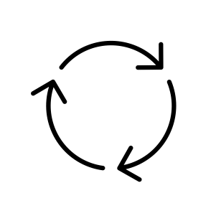














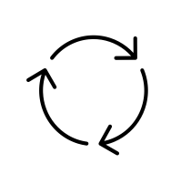

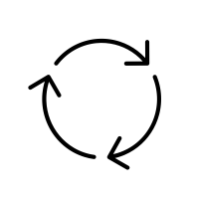









MLOps conceptual reference architecture
7
Automated model training
3 1 2
Monitor for model performance
Monitor for generated business value
6
Data Monitor
Analysis sandbox
Experiment tracking, model registry, metadata store
5
Modularized and reusable pipelines
7
4
7
Feature store*
Model in production
End user
Model results and business outcome

Slide 18


Technical components and processes in an MLOps-system
 | What | Why | How
Monitor for model performance | Automated monitoring of model results in production over time. | Know when it’s time to re-train the model (model decay) due to changes in the domain we are modeling and continuously track accuracy as this is a key parameter on the model's business case. | Dashboard to track model KPIs over time. Should include capabilities to compare competing models for the same target (where only one is actually in use). Might require control groups.
Monitor for generated business value | Automated monitoring of generated business value. E.g., monitoring if business actions based on model results generate the expected value. | Generated business value is a key parameter to track for the cross functional team when following up business side actions and creating a positive engagement behind the necessary changes in ways of working. | Dashboard for generated business value. Will typically require experiment/control groups and A/B-testing of business side actions.
Data monitor | Automated monitoring of errors and data drift in model input data, e.g., monitoring characteristics like mean, standard deviation, NULL’s, min, max, etc. | Early detection of drift in characteristics that will require model re-training. Detect errors and deviations as early as possible, e.g., when changes in data sources are not announced to all teams. | Dashboard on input data (feature store). Should be prepared to connect this as a trigger to CI/CD-tools for automated model re-training.
Feature store* | One common, well documented set of features that are used as data input to the models. Also known as analytical base table (ABT). | Avoid developing the same features multiple times for different models will save time in data development and maintenance and processing capacity. Re-use can also increase quality. | Implementation options will depend on requirements for latency. For many use cases it’s a good option to implement this as (a) wide table(s) with one row per subject for model prediction.
Modularized and reusable pipelines | Common naming conventions and structures in code. Separation of concerns in code, e.g., data split into training, test and validation could be one separate and reusable code block. | Improve and increase cooperation between data scientists. Save time when getting new hires up to speed. Easier maintenance and improvements and significant time saving by avoiding duplicate work. | Common naming conventions, common conventions for code documentation. Use of version control systems (like git).
Experiment tracking, model registry, metadata store | Experiment tracking, model registry, metadata store are separate functional components, but often delivered in one tool. | Enabling reproducibility in experiments and modelling across environments (personal sandboxes, dev/test/prod). This enables learning and transparency in the model selection and development process. | The tool should have a graphical user interface and a programmatic interface for conducting analysis and for use with an automation tool (CI/CD). Example technologies are MLFlow or Azure Machine Learing.
Automated model training | Automated model training based on a trigger from data monitor or monitor for model performance. | Save resources / time for data scientists (avoid making them all ML engineers). Increased frequency of model re-training ensures that the model better represents the current reality. | Utilize CI/CD-tools to automate the steps above that are prepared for automation.
1
2
3
4
5
6
7
19
*Feature store can have two complexity levels. Level 1: Batch data where data warehouse speed is sufficient. Level 2: Streaming data (for use cases where this is a requirement).

Slide 19
Modern data platforms

Slide 20
What should a data platform enable?
Value
(Business)
Insight and Analytics
(Data Analyst, Data Scientist)
Data
(Data Engineer)
Infrastructure and Technology
(AWS, GCP, Azure)
Data Governance

Slide 21












Key principles when building a modern data platform
Value driven implementation
Modular Architecture
Starts with business objectives and needs
Identify the insight needed to create business value
Avoid common pitfalls as starting with the technology and building complex solutions which does not create business value or is needed.
Modularity provides flexibility as single components can be replaced or changed without affecting the rest of the architecture.
Domain driven architecture where domain teams provide their capabilities as building blocks to other teams
Increase scalability and reduce dependencies
Automated and collaborative development
Flexible and scalable data storing and processing
Full flexibility in use of source data
The ELT approach enables faster implementation than the ETL process
Decoupling of loading and transformation does not halt the load when having errors in transformations.
Loading raw data directly enables more control of the data and debugging is easier
Improve collaboration and version control
Automate deployment through CI/CD
Test logic and pipeline before pushing into production
Enable short-cycles and incremental development

Slide 22
Basic components in a modern data platform
Orchestration
Scheduling
Source
Store
Process and
Store
transformation
Data Lake
Data Warehouse
Transformation
Batch ingest
Analytic /
Data
Warehouse
Dashboard
Custom Ingest
Machine Learning & Analytics
Data Replication/ingest as a service
Business Intelligence
DevOps
Version Control
CI/CD

Slide 23
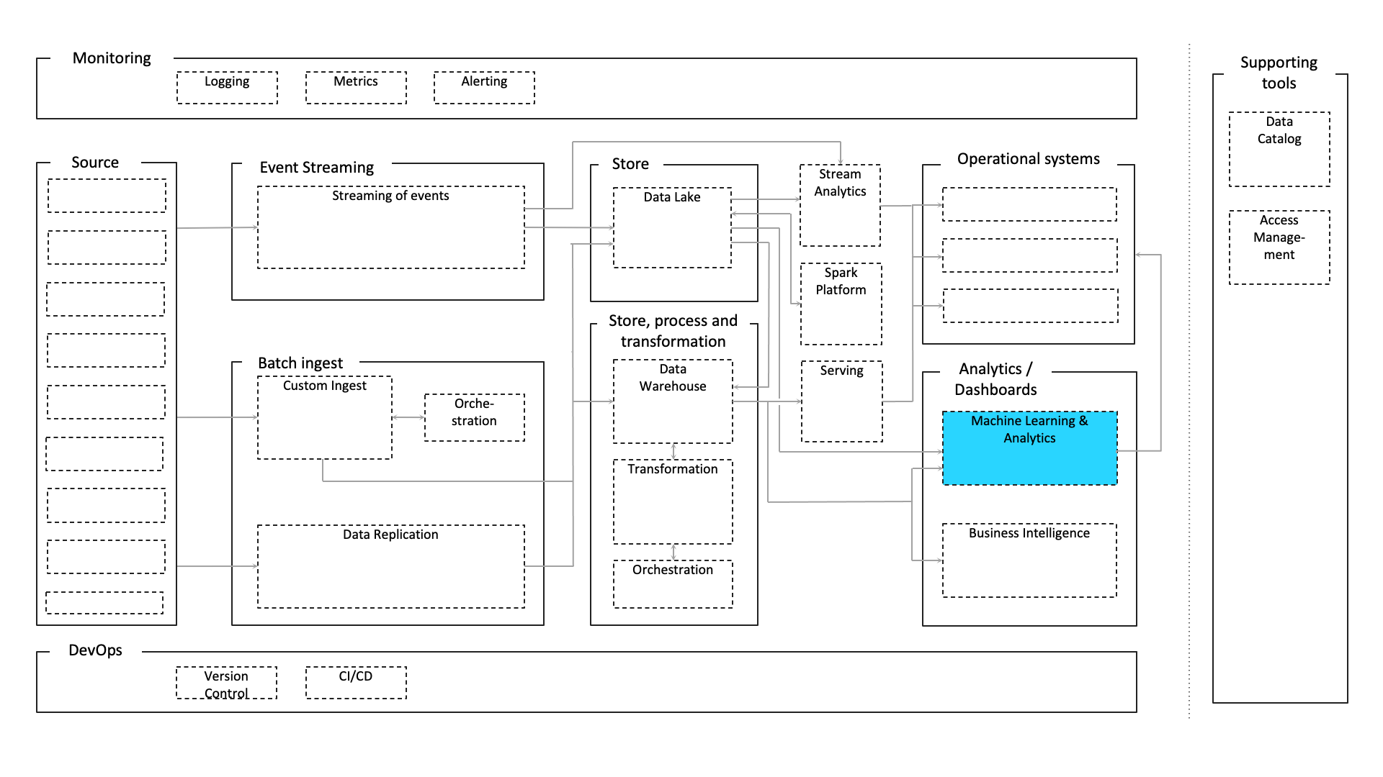

Analytics/Machine learning
Machine learning “gives computers the ability to learn without being explicitly programmed”. This is possible today as data is more accessible than before.
There are five important steps in a common ML workflow, get data, clean, prepare and manipulate data, train model, test model and improve. There are several tools that help
you in handling the infrastructure around your ML code.
This is a large topic, and we are only touching upon it in this material where we are
looking at tools that provide infrastructure around your ML-code, for more information on how to operationalize your ML code, see our MLOps framework – An introduction to MLOps by BearingPoint.
Cloud native
Serverless compute services that provides
updated infrastructure and all the resources needed to run your application.
You write the (model) code yourself, and then the service handles the rest.
Tools:
Azure Functions
AWS Lambda Functions
(Databricks +) mlflow
mlflow open source platform to manage the ML
lifecycle
Designed to work with any ML library, algorithm,
deployment tool or language
Can run a hosted version of mlflow on Databricks
Other options
Self-deploy on PaaS (Kubernetes/ECS)

Slide 24
Monitoring
Logging
Metrics
Alerting
Orchestration
Scheduling
Source
Event Streaming
Store
Process and transformation
Operational system
Supporting
Store
Stream
tools
Streaming of events
Data Lake
Processing (Spark Platform)
Data Lake
Data Warehouse
Stream processin g
Data Catalog
Transformation
Access
Management
Batch ingest
Analytic /
Data
Warehouse
Dashboard
Custom Ingest
Machine Learning & Analytics
Serving
Serving
Data Replication/ingest as a service
Business Intelligence
DevOps
Version Control
CI/CD

Slide 25
MLOps & Data platform at Plaace

Slide 26
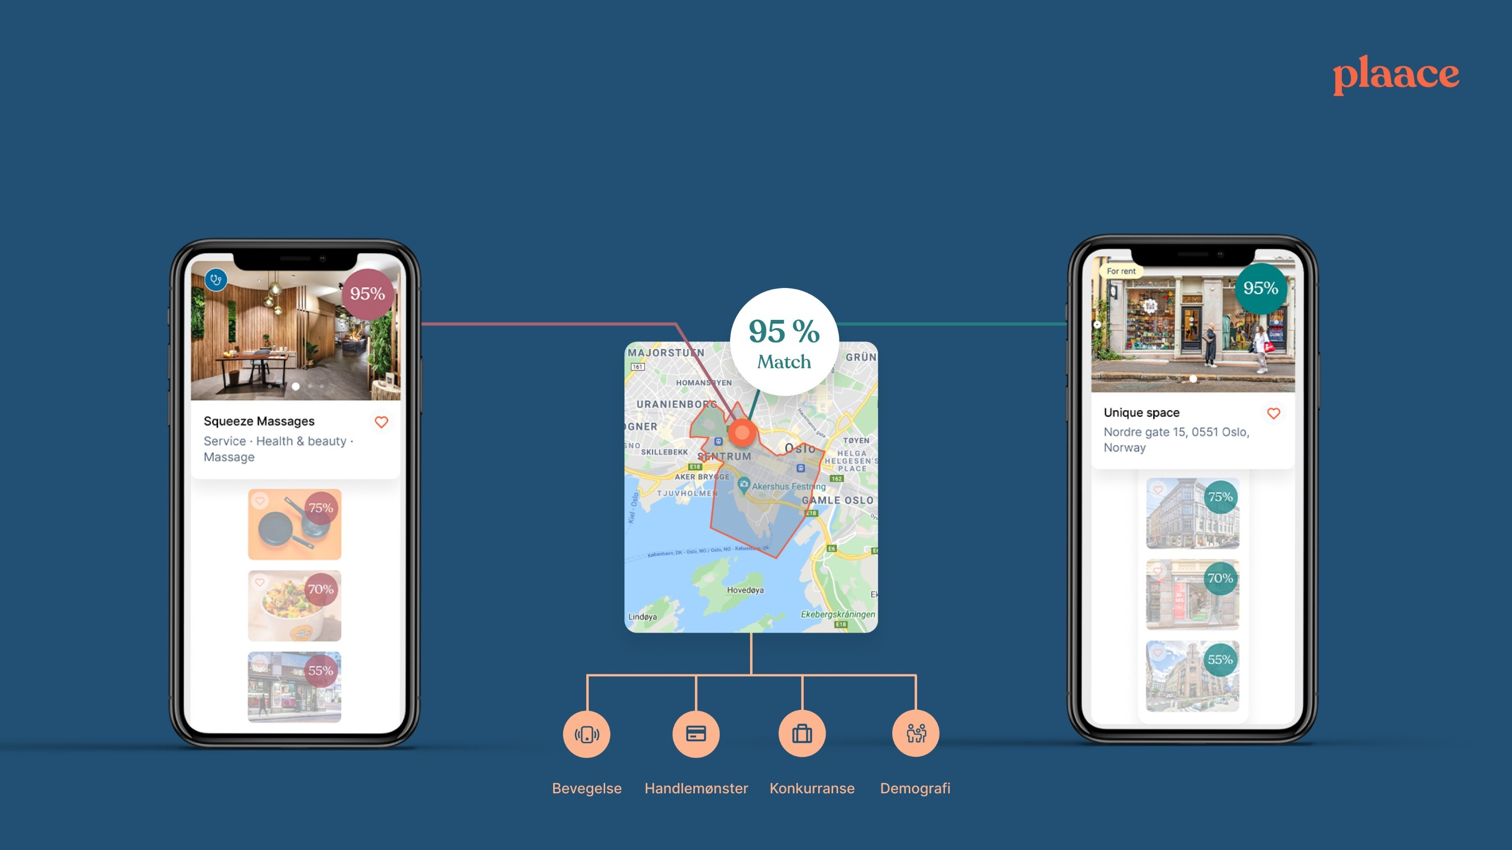
Plaace: neste generasjon matching platform for retail property
27

Slide 27



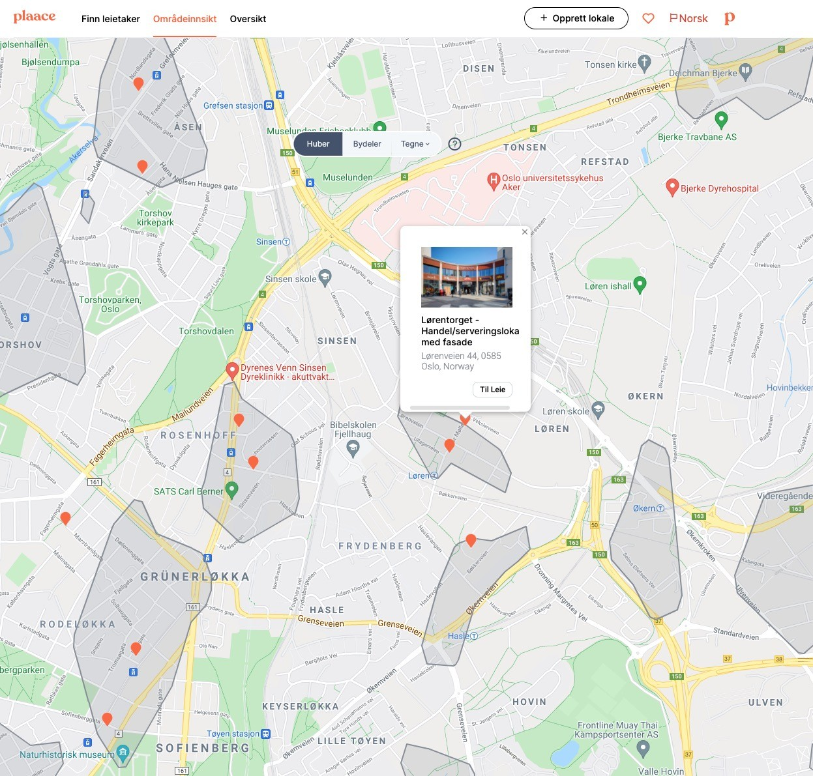



















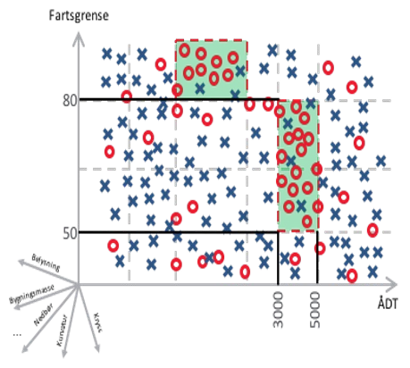


Plaace develops automatic area recommendations with machine learning
Input
Recommendation model
Recommends grunnkretser with highest “match” score

Slide 28
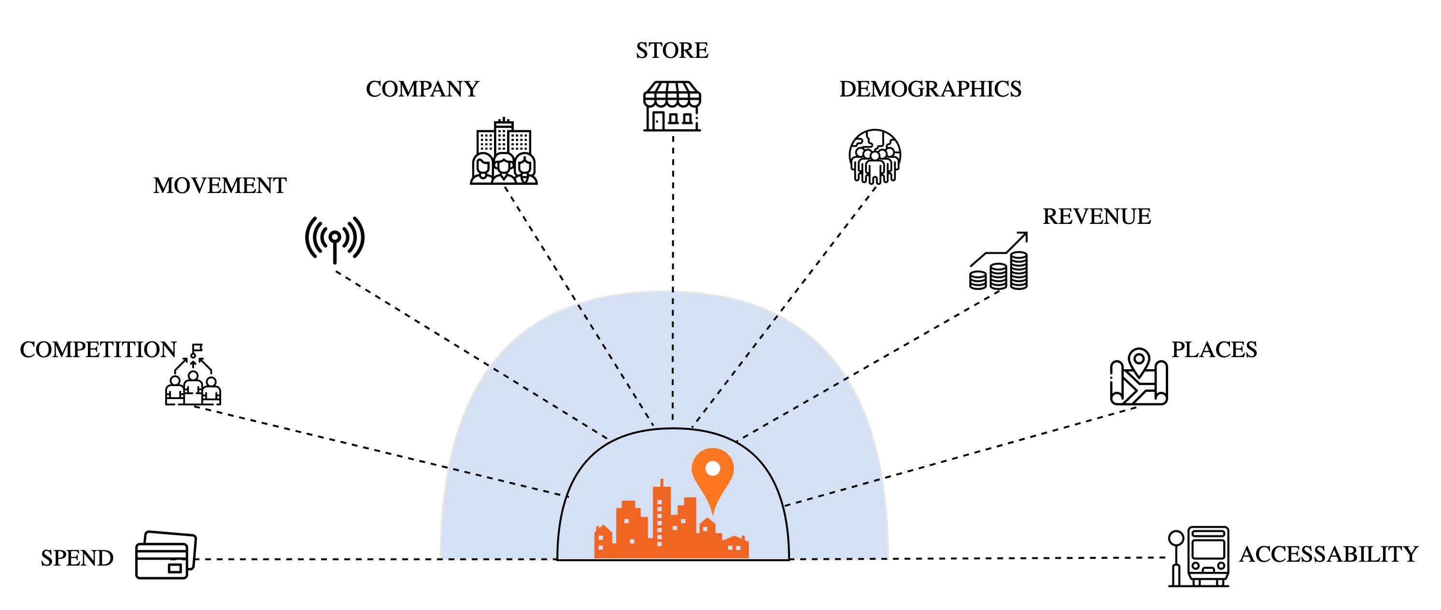
A recommendation is based on several factors
AREA RECOMMENDATION

Slide 29

We use MLOps as our work method
Data Collection
Design
Model development
Develop new features
Production
Operationalise & scale model
ML UI/UX on platform
First ml user interaction design
Add new data to model
Project definition
Organizational Data & Decision Support
Data Pipelines & Quality
Infrastructure & Tooling Team & Processes

Slide 30





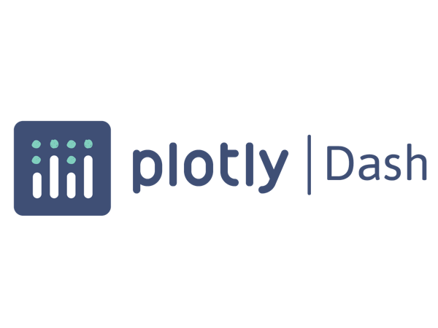






















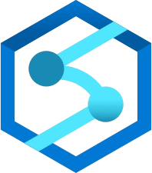


End to end Azure architecture for IoT ML Ops
Production
Machine
Data processing
Analytics
Output
Web interface
Sensors Cloudrail Box
Azure Data Lake Storage
Azure Kubernetes Azure Machine Service Learning
Camera
Event Hub
Event Grid
PowerBI Dashboards
Machine
Azure Stream Analytics
IoT Hub
Sensors
Export tool from log files
Azure Stream Analytics
Azure Data Lake Storage
Other systems
SQL Server
DataFactory
Cosmos DB
Databricks
Databricks
Synapse Analytics
36

Slide 31
Monitoring
Logging
Metrics
Alerting
Orchestration
Scheduling
Source
Event Streaming
Store
Process and transformation
Operational system
Supporting
Store
Stream
tools
Streaming of events
Data Lake
Processing (Spark Platform)
Data Lake
Data Warehouse
Stream processin g
Data Catalog
Transformation
Access
Management
Batch ingest
Analytic /
Data
Warehouse
Dashboard
Custom Ingest
Machine Learning & Analytics
Serving
Serving
Data Replication/ingest as a service
Business Intelligence
DevOps
Version Control
CI/CD

Slide 32
ML system design workshop

Slide 33
7
Automatisert modelltrening
3
1
2
Overvåkning av modellers treffsikkerhet
6
Overvåkning av data
Måling av generert verdi
Analysemiljø
Eksperimentstyring, modellbibliotek, metadataregister
5
Modulariserte + gjenbrukbare pipelines
7
4
7
Feature store*
Modell i produksjon
Sluttbruker
Modellresultater og forretningsmessig utfall
32

Slide 34
Practical experiences -
What do you wonder about?

Slide 35


34

Slide 36



Example architecture (OSS)
English translation
Model analysis and continuous improvement
AI Governance
Model registry
Prediction loop monitor
Performanc e monitor
Production server (DS PROD)
Models
ML Operations
..
ML
Prediction service
Predictions
docker_run
Data monitor
CD-stage
“Putting into production”
Trigger (DataStage)
Mini-data engineering
ABT / Feature store
DS Development
Development server (DS DEV) – CI-stage
Data extraction (sql alchemy)
Ad-hoc analysis
Sandbox (feature engineering)
Model training
Model testing
PC
Experiments
PC
PC
35

